Slide 1
Chapter -I
Mathematical foundation for Coding Theory
Modular Arithmetic, Congruence and field

Slide 2
INTEGER ARITHMETIC
In integer arithmetic, we use a set and a few operations. You are familiar with this set and the corresponding operations, but they are reviewed here to create a background for modular arithmetic.
Topics discussed in this section:
Set of Integers
Binary Operations
Integer Division
Divisibility

Slide 3

Set of Integers
The set of integers, denoted by Z, contains all integral numbers (with no fraction) from negative infinity to positive infinity.
Figure 1.1 The set of integers

Slide 4
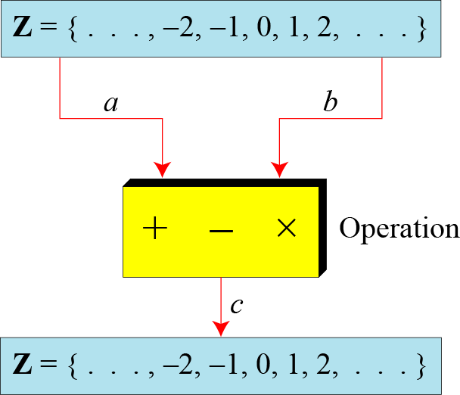
Binary Operations
In cryptography, we are interested in three binary operations applied to the set of integers. A binary operation takes two inputs and creates one output.
Three binary operations for the set of integers

Slide 5
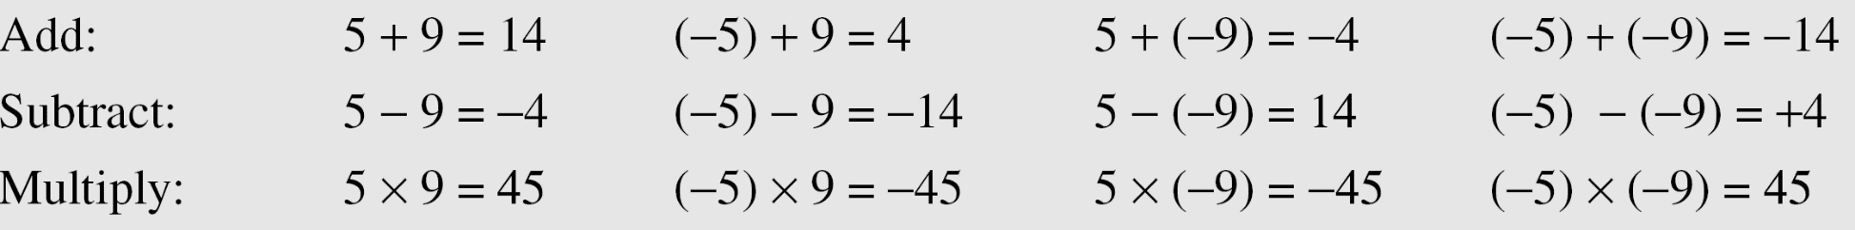
Continued
Example
The following shows the results of the three binary operations on two integers. Because each input can be either positive or negative, we can have four cases for each operation.

Slide 6
Integer Division
In integer arithmetic, if we divide a by n, we can get q
And r . The relationship between these four integers can be shown as
a = q × n + r

Slide 7
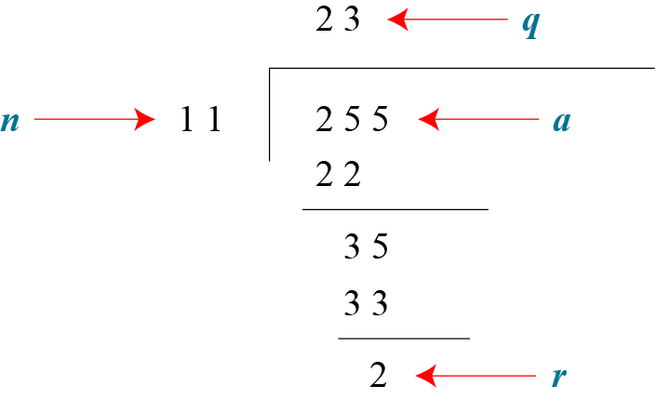
Continued
Example 2.2
Assume that a = 255 and n = 11. We can find q = 23 and R = 2 using the division algorithm.
finding the quotient and the remainder

Slide 8
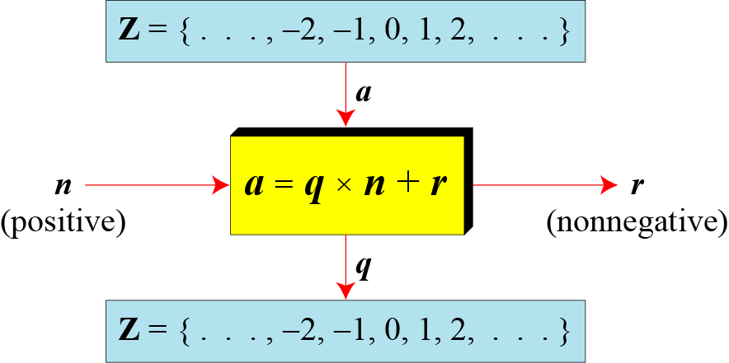
Continued
Division algorithm for integers

Slide 9
Continued
Example
When we use a computer or a calculator, r and q are negative when a is negative. How can we apply the restriction that r needs to be positive? The solution is simple, we decrement the value of q by 1 and we add the value of n to r to make it positive.

Slide 10

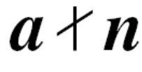
Divisbility
If a is not zero and we let r = 0 in the division relation, we get
a = q × n
If the remainder is zero,
If the remainder is not zero,

Slide 11
Continued
Properties
Property 1: if a|1, then a = ±1.
Property 2: if a|b and b|a, then a = ±b.
Property 3: if a|b and b|c, then a|c.
Property 4: if a|b and a|c, then
a|(m × b + n × c), where m
and n are arbitrary integers

Slide 12

Continued
Note
Fact 1: The integer 1 has only one
divisor, itself.
Fact 2: Any positive integer has at least
two divisors, 1 and itself (but it
can have more).

Slide 13
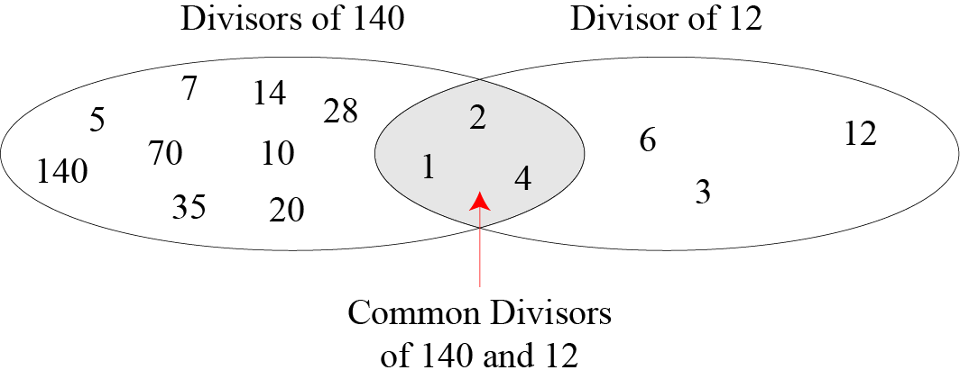
Continued
Common divisors of two integers

Slide 14
Continued
Note
Greatest Common Divisor
The greatest common divisor of two positive integers is the largest integer that can divide both integers.
Note
Euclidean Algorithm
Fact 1: gcd (a, 0) = a
Fact 2: gcd (a, b) = gcd (b, r), where r is
the remainder of dividing a by b

Slide 15
MODULAR ARITHMETIC
The division relationship (a = q × n + r) discussed in the previous section has two inputs (a and n) and two outputs (q and r). In modular arithmetic, we are interested in only one of the outputs, the remainder r.
Topics discussed in this section:
Modular Operator
Set of Residues
Congruence
Operations in Z_{n}
Addition and Multiplication Tables
Different Sets

Slide 16
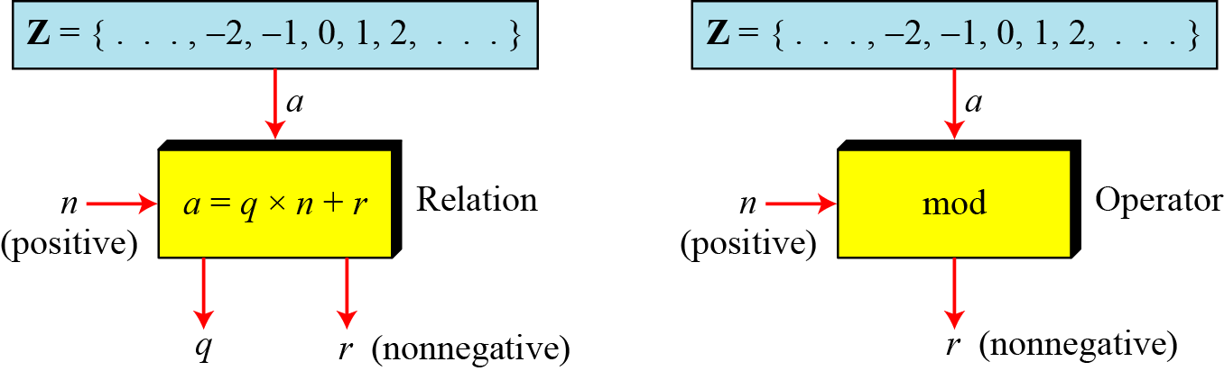
Modulo Operator
The modulo operator is shown as mod. The second input (n) is called the modulus. The output r is called the residue.
Figure 1.9 Division algorithm and modulo operator

Slide 17
Continued
Example
Find the result of the following operations:
a. 27 mod 5 b. 36 mod 12
c. −18 mod 14 d. −7 mod 10
Solution
Dividing 27 by 5 results in r = 2
Dividing 36 by 12 results in r = 0.
c. Dividing −18 by 14 results in r = −4. After adding the modulus r = 10
d. Dividing −7 by 10 results in r = −7. After adding the modulus to −7, r = 3.

Slide 18
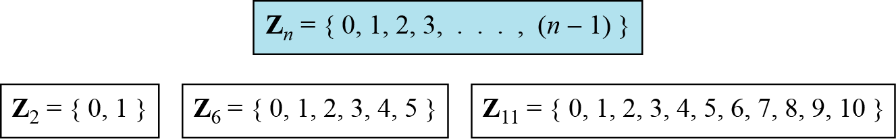
Set of Residues
The modulo operation creates a set, which in modular arithmetic is referred to as the set of least residues modulo n, or Z_{n}.
Some Z_{n} sets

Slide 19
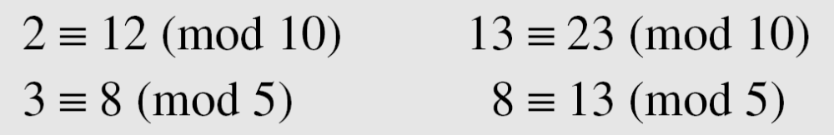
Congruence
To show that two integers are congruent, we use the congruence operator ( ≡ ). For example, we write:

Slide 20
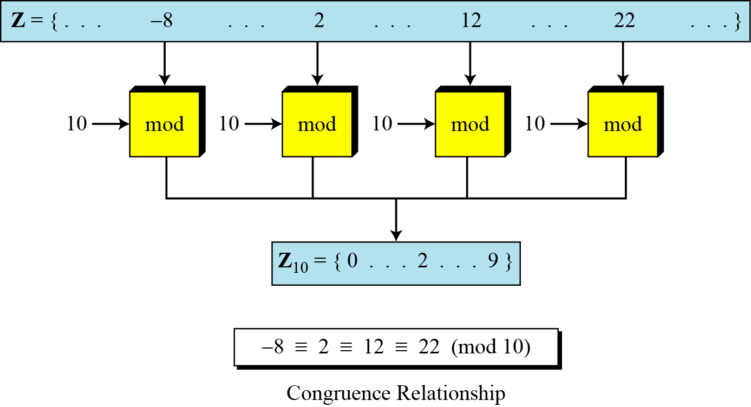
Continued
Concept of congruence

Slide 21
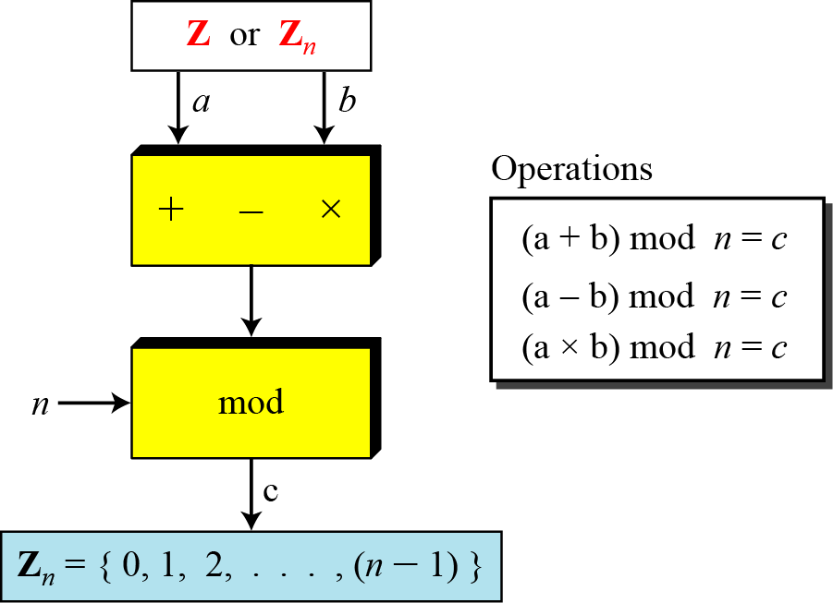
Operation in Z_{n}
The three binary operations that we discussed for the set Z can also be defined for the set Zn. The result may need to be mapped to Zn using the mod operator.
Binary operations in Z_{n}

Slide 22
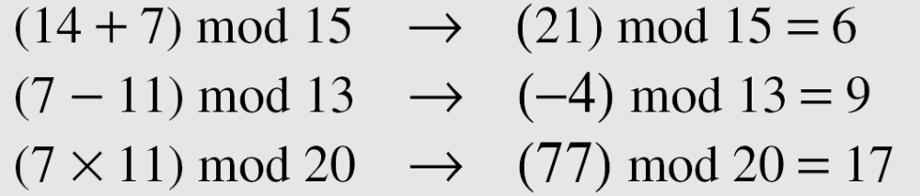
Continued
Example
Perform the following operations (the inputs come from Zn):
a. Add 7 to 14 in Z15.
b. Subtract 11 from 7 in Z13.
c. Multiply 11 by 7 in Z20.
Solution

Slide 23
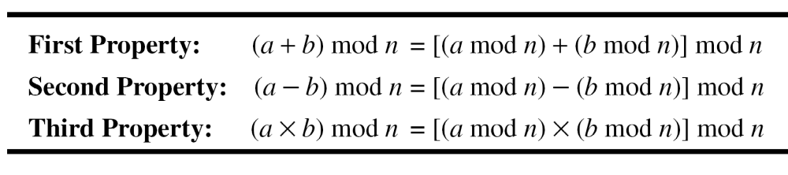
Continued
Properties

Slide 24
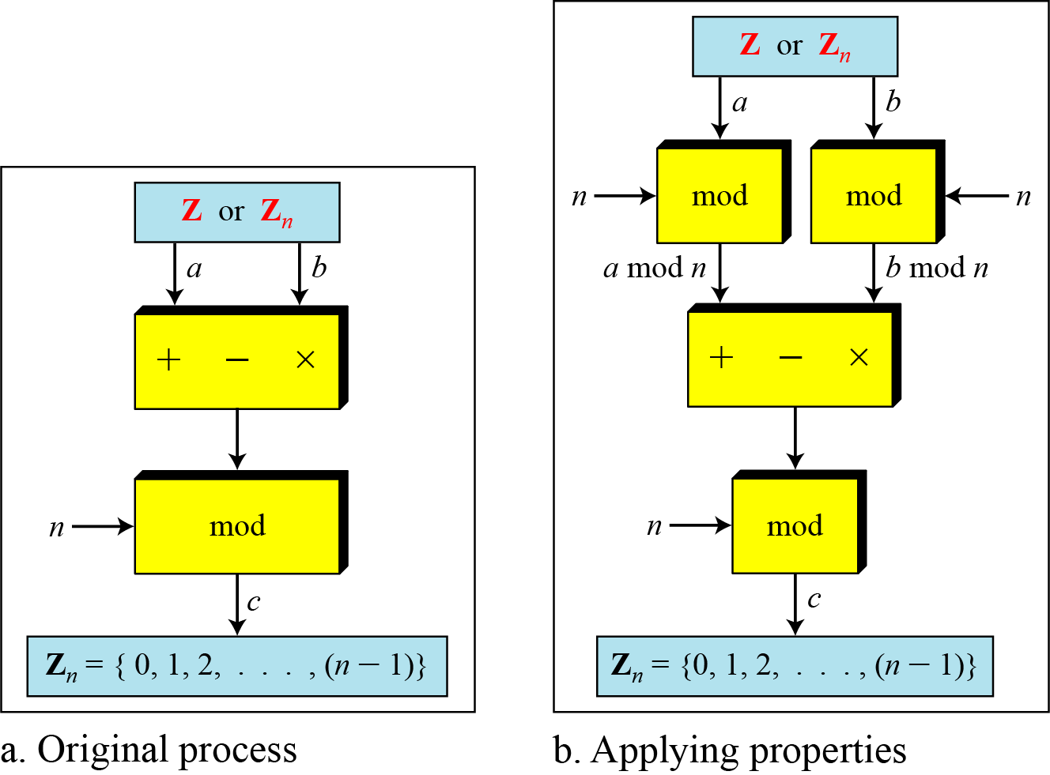
Continued
Properties of mode operator

Slide 25
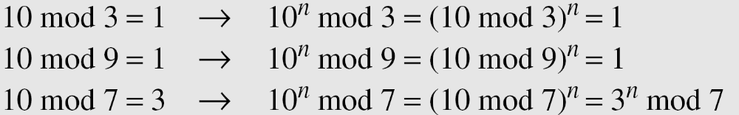
Continued
Example
In arithmetic, we often need to find the remainder of powers of 10 when divided by an integer.

Slide 26
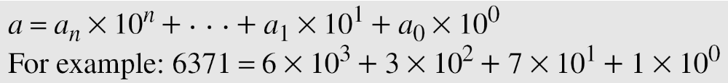
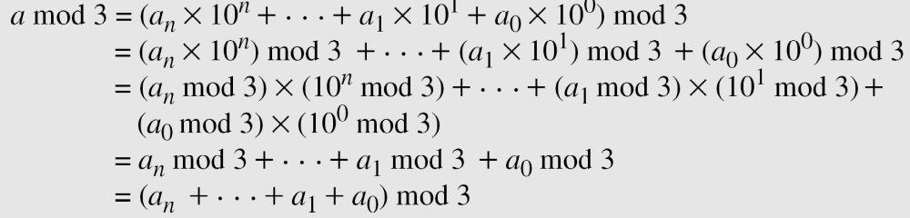
Continued
Example
We have been told in arithmetic that the remainder of an integer divided by 3 is the same as the remainder of the sum of its decimal digits. We write an integer as the sum of its digits multiplied by the powers of 10.

Slide 27
Inverses
When we are working in modular arithmetic, we often need to find the inverse of a number relative to an operation. We are normally looking for an additive inverse (relative to an addition operation) or a multiplicative inverse (relative to a multiplication operation).

Slide 28

Continued
Additive Inverse
In Z_{n}, two numbers a and b are additive inverses of each other if
Note
In modular arithmetic, each integer has an additive inverse. The sum of an integer and its additive inverse is congruent to 0 modulo n.

Slide 29
Continued
Example
Find all additive inverse pairs in Z10.
Solution
The six pairs of additive inverses are (0, 0), (1, 9), (2, 8), (3, 7), (4, 6), and (5, 5).

Slide 30

Continued
Multiplicative Inverse
In Z_{n}, two numbers a and b are the multiplicative inverse of each other if
Note
In modular arithmetic, an integer may or may not have a multiplicative inverse.
When it does, the product of the integer and its multiplicative inverse is congruent to 1 modulo n.

Slide 31
Continued
Example
Find the multiplicative inverse of 8 in Z₁₀.
Solution
There is no multiplicative inverse because gcd (10, 8) = 2 ≠ 1. In other words, we cannot find any number between 0 and 9 such that when multiplied by 8, the result is congruent to 1.
Example
Find all multiplicative inverses in Z₁₀.
Solution
There are only three pairs: (1, 1), (3, 7) and (9, 9). The numbers 0, 2, 4, 5, 6, and 8 do not have a multiplicative inverse.

Slide 32
Continued
Example
Find all multiplicative inverse pairs in Z₁₁.
Solution
We have seven pairs: (1, 1), (2, 6), (3, 4), (5, 9), (7, 8), (9, 9), and (10, 10).

Slide 33
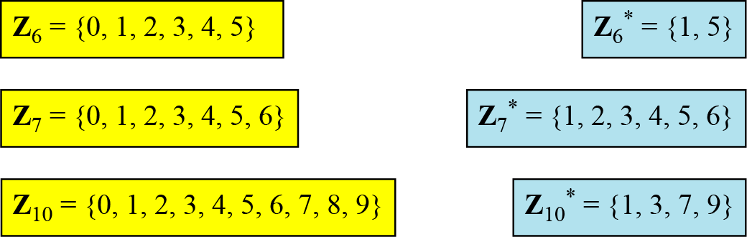
Different Sets
Some Z_{n} and Z_{n}* sets
Note
We need to use Zn when additive inverses are needed; we need to use Zn* when multiplicative inverses are needed.

Slide 34
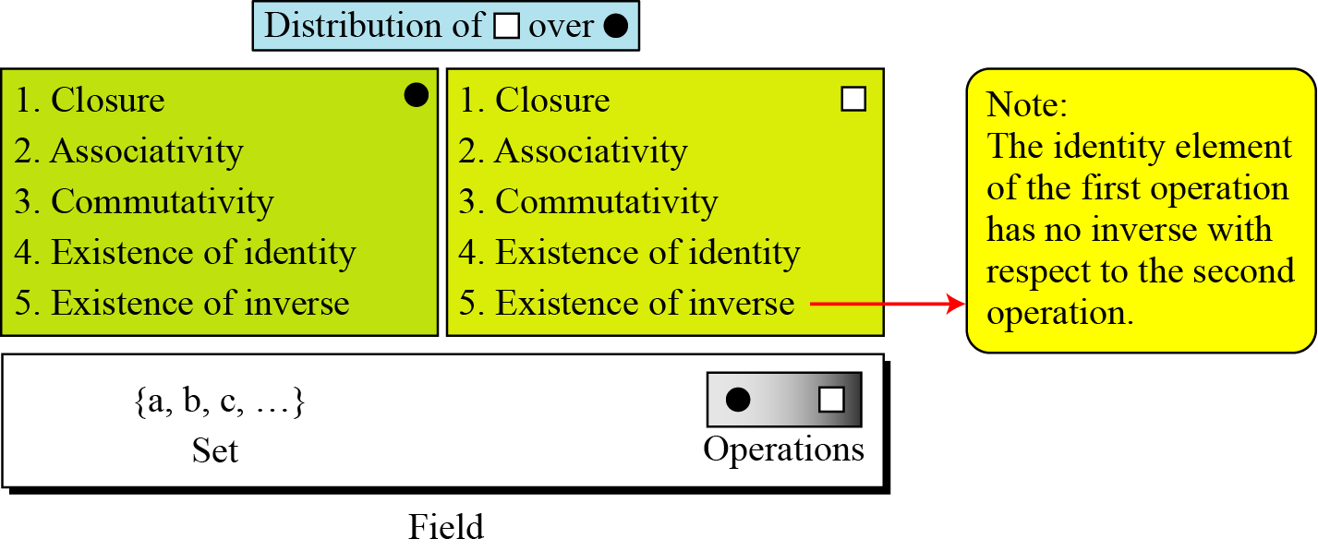
Field
A field, denoted by F = <{…}, •, _x0001_> is a commutative ring in which the second operation satisfies all five properties defined for the first operation except that the identity of the first operation has no inverse.
Figure Field
4.<number>

Slide 35
Continued
Finite Fields
Galois showed that for a field to be finite, the number of elements should be p^{n}, where p is a prime and n is a positive integer.
Note
A Galois field, GF(p^{n}), is a finite field with p^{n} elements.
4.<number>

Slide 36
Continued
GF(p) Fields
When n = 1, we have GF(p) field. This field can be the set Z_{p}, {0, 1, …, p − 1}, with two arithmetic operations.
4.<number>

Slide 37
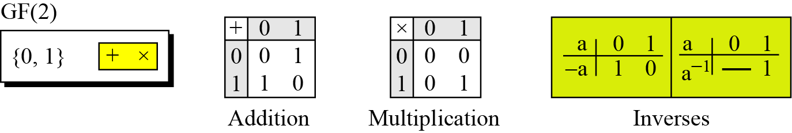
Continued
Example
A very common field in this category is GF(2) with the set {0, 1} and two operations, addition and multiplication, as shown in the following figure .
Figure GF(2) field
4.<number>

Slide 38
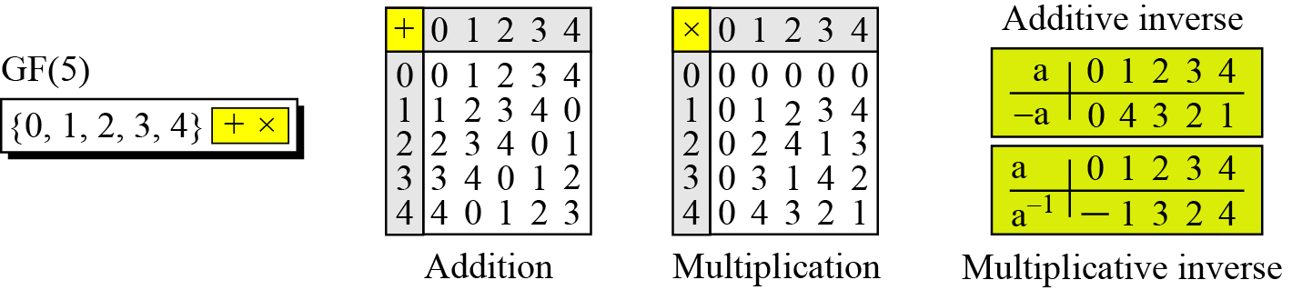
Continued
Example
We can define GF(5) on the set Z₅ (5 is a prime) with addition and multiplication operators as shown in the following
GF(5) field
4.<number>

Slide 39
GF(2^{n}) FIELDS
In cryptography, we often need to use four operations (addition, subtraction, multiplication, and division). In other words, we need to use fields. We can work in GF(2^{n}) and uses a set of 2^{n} elements. The elements in this set are n-bit words.
Topics discussed in this section:
Polynomials
Using A Generator
Summary
4.<number>

Slide 40
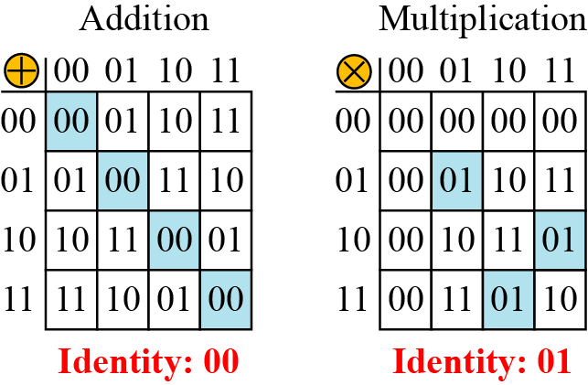
Continued
Example
Let us define a GF(2²) field in which the set has four 2-bit words: {00, 01, 10, 11}. We can redefine addition and multiplication for this field in such a way that all properties of these operations are satisfied, as shown in Figure 4.8.
Figure 4.8 An example of GF(2²) field
4.<number>

Slide 41
Polynomials
A polynomial of degree n − 1 is an expression
of the form
where x^{i} is called the ith term and a_{i} is called coefficient of the ith term.
4.<number>

Slide 42
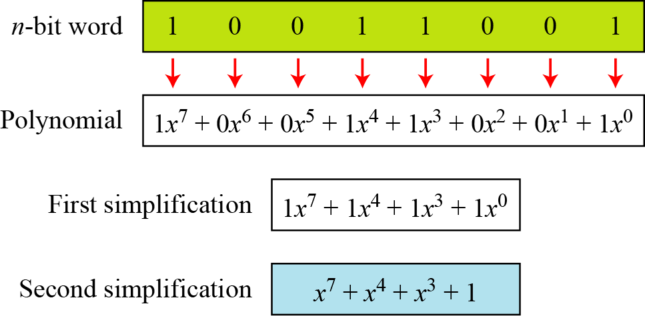
Continued
Example 2.15
The following figure show how we can represent the 8-bit word (10011001) using a polynomials.
Representation of an 8-bit word by a polynomial
4.<number>

Slide 43
Continued
Example
To find the 8-bit word related to the polynomial x⁵ + x² + x, we first supply the omitted terms. Since n = 8, it means the polynomial is of degree 7. The expanded polynomial is
This is related to the 8-bit word 00100110.
4.<number>

Slide 44
Continued
GF(2^{n}) Fields
Note
Polynomials representing n-bit words use two fields: GF(2) and GF(2^{n}).
4.<number>

Slide 45
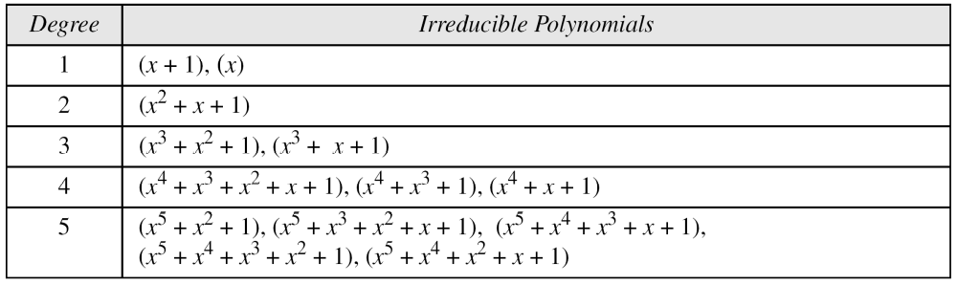
Continued
Modulus
For the sets of polynomials in GF(2^{n}), a group of polynomials of degree n is defined as the modulus. Such polynomials are referred to as irreducible polynomials.
List of irreducible polynomials
4.<number>

Slide 46
Continued
Addition
Note
Addition and subtraction operations on polynomials are the same operation.
4.<number>

Slide 47
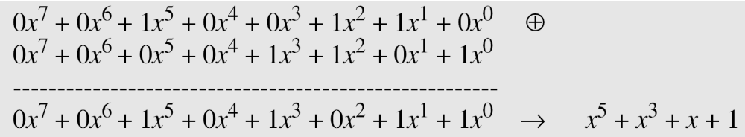
Continued
Example
Let us do (x⁵ + x² + x) ⊕ (x³ + x² + 1) in GF(2⁸). We use the symbol ⊕ to show that we mean polynomial addition. The following shows the procedure:
4.<number>

Slide 48
Continued
Example
There is also another short cut. Because the addition in GF(2) means the exclusive-or (XOR) operation. So we can exclusive-or the two words, bits by bits, to get the result. In the previous example, x⁵ + x² + x is 00100110 and x³ + x² + 1 is 00001101. The result is 00101011 or in polynomial notation x⁵ + x³ + x + 1.
4.<number>

Slide 49
Continued
Multliplication
1. The coefficient multiplication is done in GF(2).
2. The multiplying x^{i} by x^{j} results in x^{i+j}.
3. The multiplication may create terms with degree more than n − 1, which means the result needs to be reduced using a modulus polynomial.
4.<number>

Slide 50
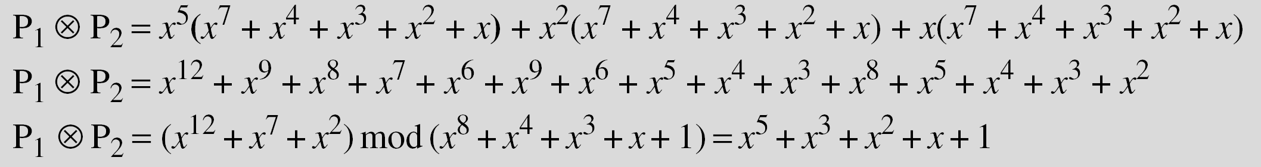
Continued
Example
Find the result of (x⁵ + x² + x) ⊗ (x⁷ + x⁴ + x³ + x² + x) in GF(2⁸) with irreducible polynomial (x⁸ + x⁴ + x³ + x + 1). Note that we use the symbol ⊗ to show the multiplication of two polynomials.
Solution
To find the final result, divide the polynomial of degree 12 by the polynomial of degree 8 (the modulus) and keep only the remainder. Figure 4.10 shows the process of division.
4.<number>

Slide 51
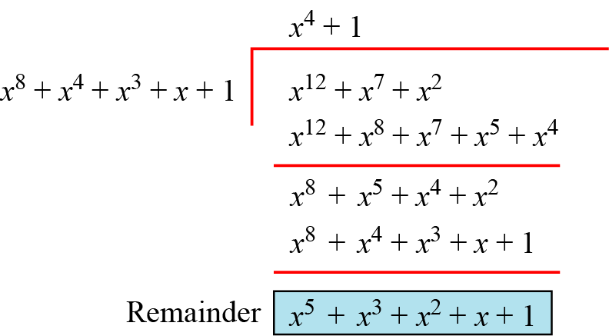
Continued
Polynomial division with coefficients in GF(2)
4.<number>

Slide 52
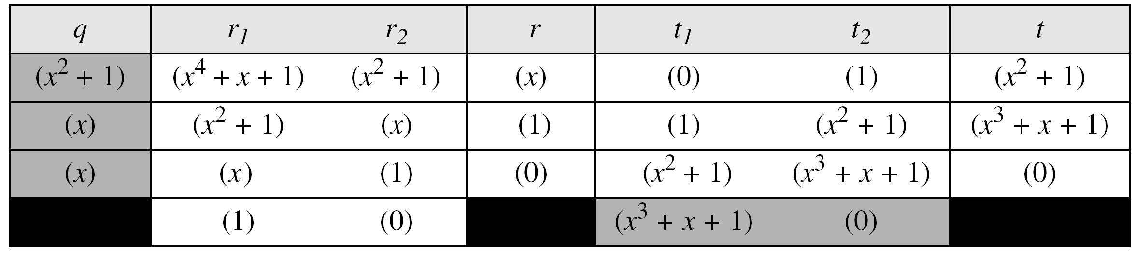
Continued
Example
In GF (2⁴), find the inverse of (x² + 1) modulo (x⁴ + x + 1).
Solution
The answer is (x³ + x + 1) as shown in following table
4.<number>

Slide 53
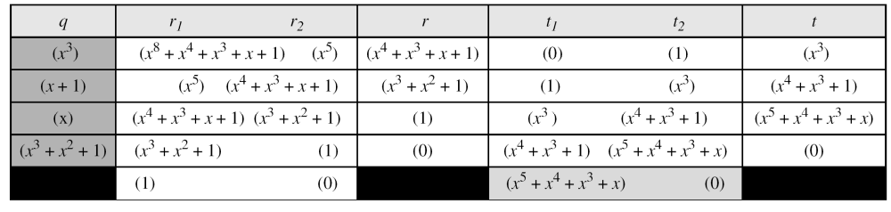
Continued
Example
In GF(2⁸), find the inverse of (x⁵) modulo (x⁸ + x⁴ + x³ + x + 1).
Solution
The answer is (x⁵ + x⁴ + x³ + x) as shown in following table
4.<number>

Slide 54
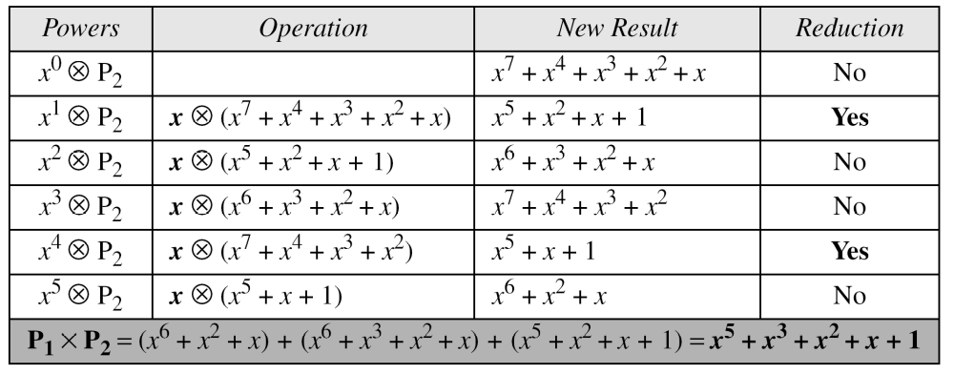
2.2.1 Continued
Example 2.22
Continued
Table 2.7 An efficient algorithm (Example 2.22)
4.<number>

Slide 55
Continued
Example
The GF(2³) field has 8 elements. We use the irreducible polynomial (x³ + x² + 1) and show the addition and multiplication tables for this field. We show both 3-bit words and the polynomials. Note that there are two irreducible polynomials for degree 3. The other one, (x³ + x + 1), yields a totally different table for multiplication.
4.<number>

Slide 56
Continued
Example
Continued
Addition table for GF(2³)
4.<number>

Slide 57
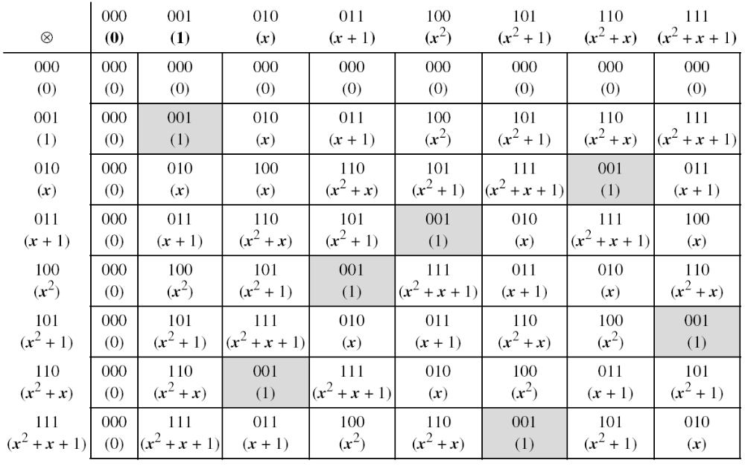
Continued
Example
Continued
Multiplication table for GF(2³)
4.<number>

Slide 58
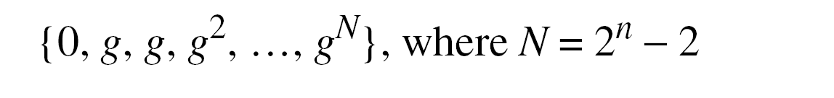
Using a Generator
Sometimes it is easier to define the elements of the GF(2^{n}) field using a generator.
4.<number>

Slide 59
Continued
Example
Generate the elements of the field GF(2⁴) using the irreducible polynomial ƒ(x) = x⁴ + x + 1.
Solution
The elements 0, g⁰, g¹, g2, and g³ can be easily generated, because they are the 4-bit representations of 0, 1, x², and x³. Elements g⁴ through g¹⁴, which represent x⁴ though x¹⁴ need to be divided by the irreducible polynomial. To avoid the polynomial division, the relation ƒ(g) = g⁴ + g + 1 = 0 can be used (See next slide).
4.<number>

Slide 60
Continued
Example
Continued
4.<number>

Slide 61
Summary
The finite field GF(2^{n}) can be used to define four operations of addition, subtraction, multiplication and division over n-bit words. The only restriction is that division by zero is not defined.
4.<number>

